Slide 1
Behavior Change Communication Strategy for H5N1 in Egypt
Dee Bennett
for
Food and Agriculture Organization
7 January 2014

Slide 2
Assessment: Dec 30 – January 3
Interviews and Meetings
Visits 2 live bird markets: Minya and Qualibya
Interviews with household and Sector 3 farmers
Interviews at markets with household farmers, transporters
Interviews with service providers, educator
Meetings with government officials
Interviews with CAHO and Field Epidemiologists

Slide 3
Observations
At risk audiences for H5N1 virus are a select population in the poultry industry; not the general population
High awareness but low practice of correct behaviors among all populations
Vaccine has created a false sense of security
CAHO activities and trainings are relevant to H5N1 virus conditions in 2009 and 2012 – it needs to be updated to fit the 2015 situation

Slide 4
Observations
H5N1 virus is not just an animal health issue
H5N1 virus needs to be elevated to national priority status
Multi-sectoral solution
Gender is an important component to the solution
Major barriers to change are social and cultural norms and policy and regulator
Current communication and outreach activities have not been designed to create behavior change

Slide 5
Observations
There does not seem to be any recent (within 3 years) qualitative or quantitative research conducted among the key at risk audiences and influentials
A strategic communication plan for operations needs to be designed
Communication is ad hoc

Slide 6
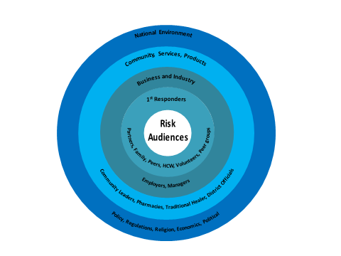
Socio-Ecological BCC Theory

Slide 7
Capacity Building and support
Advocacy
Public Relations
Web site
Materials
Advocacy and Coordination
Research and dissemination
Public Relations
Advocacy Materials
National Environment
Community, Services, Products
Business and Industry
Community Leaders, Pharmacies, Traditional Healer, District Officials
Partners, Family, Peers, HCW, Volunteers, Peer groups
1st Responders
Employers, Managers
Interpersonal Communication
Limited Mass Media
Communication Materials
Public Relations
Risk
Audiences
Policy, Regulations, Religion, Economics, Political
Training
Key Behaviours -messages
Communication Materials
Social media
Public Relations
Advocacy
Website
Peer education

Slide 8
Four Strategies – Integrated Approach
Evidence-based Strategies
Advocacy
Capacity Building
Community-based Communication (CBC) and Social Mobilization
Internal and External Communication

Slide 9
Advocacy
Objective: Provide multi-sectoral support and coordination for H5N1 virus from national-level to local and community-levels
Strategies Advocacy, Public Relations, Social Media, Messages & Materials
Audiences National Policy-Makers, District Authorities, Private Sector, Civil Society, Professional Associations, Media

Slide 10
Capacity Building
Objective Strengthen the technical skills and knowledge of front-line workers and at risk audiences of the H5N1 virus
Strategies: Capacity Building, Materials and Messages, Organization of Cooperatives and Professional Trade Associations, Demonstrations and Events, Mobilization, Social Media & Social Impact Gaming
Audiences: Public/Private Vets, CHW, Household/Sec 3 Farmers, Educators, Service Providers, Peers

Slide 11
Community-based Communication Social Mobilization
Objective Implement an evidence-based integrated communication activity to affect changes in behavior related to bio-security and animal husbandry
Strategies Demonstrations, Co-operatives, Professional Assoc., Community Meetings, Mobilization, Social Media, Social Impact Games
Audiences Public and Private Vets, Community Health Workers, Household and Sector 3 Farmers, Educators, Service Providers, District Leaders, Peers

Slide 12
Internal and External Communication
Objective Coordinate strategic communication and public information on H5N1 virus within the Ministry and intra-agency and to the public
Strategies: Capacity Building, Social Media, Traditional Media, Public Relations, Advocacy, Media Relations, Messages, Materials
Audiences Policy-makers, Business Leaders, National and International Media, Multi-sectoral Decision-makers, General Public

Slide 13
Monitoring and Evaluation
Survey
Observation
SMS – Self Reporting
Content Analysis

Slide 14
Implementation Year 1
Year 1
Identify 2 districts in 2 governorates
First six months research, design, develop, organize, conduct capacity building
Second six months soft launch in 2 districts
End of Year 1 evaluation and monitoring
Lessons Learned
Adjust program based on evaluation
Reporting

Slide 15
Thank You
Questions?
Comments?

